Slide 1




Code Guard: A Robust Error Detector and Highlighter for Codebases
BY:
S. LIKHITHA- 192211956
S. KUSUMA SREE- 192210094
N. GAYANI- 192211989

Slide 2
ABSTRACT
Code Guard is a cutting-edge tool with strong error detection and highlighting features that improves the quality and maintainability of codebases. Code Guard searches codebases for grammatical mistakes, code smells, security flaws, and performance snags using sophisticated algorithms and configurable rulesets.
The tool offers real-time feedback and visually highlights problematic regions within the code editor or IDE, integrating smoothly into existing development workflows.
Code Guard promotes a culture of continuous improvement and high-quality software delivery by enabling developers to proactively discover and address issues with numerous programming languages and frameworks

Slide 3
INTRODUCTION
01
02
03
Error detection
RealTimeHighliging
Intuitive Reporting

Slide 4

01
Upholding high-quality code is essential in the hectic field of software development to guarantee the dependability, security, and maintainability of software programs.
However, it gets harder to find problems and pinpoint areas that need repair as codebases get bigger and more complicated.
Large-scale projects cannot benefit from the time-consuming and prone to human error nature of traditional manual code review and testing approaches .
Offering a strong mistake detection and highlighting method for codebases.

Slide 5


LITERATURE REVIEW
A review of existing literature related to tools for validating input strings using SLR parsing technique reveals a limited body of work in comparison to other areas of tool for SLR parser.
While much attention has been given to the development of GUIs for linguistic tools, the specific application of SLR parsing techniques for input string validation has received less emphasis.
One significant contribution in this direction is the work by , where the authors explore the integration of SLR parsing techniques into a tool for validating input strings.

Slide 6
The Need for Code Guard
As codebases grow in complexity, they become increasingly prone to errors, making it challenging for developers to maintain and improve them. Code Guard addresses this issue by providing robust error detection and highlighting capabilities, empowering developers to identify and resolve issues more efficiently.

Slide 7
METHODOLOGY
The process for creating "A Tool for Validating Input String Using SLR Parsing Technique" entails a number of crucial phases that are meant to collect pertinent information, configure the environment for development, describe the algorithm with examples, and write the code efficiently.
The first step in the technique is to carry out in-depth research to collect pertinent data and information that will guide the project.
Reviewing previous studies, research articles, and documentation on SLR parsing strategies, input string validation procedures, and pertinent programming languages and frameworks are all part of this process. The next stage is to set up the development environment after the research phase.

Slide 8
Software Requirements:
Operating Systems: Windows 10 or higher, macOS 10.15 or higher, Linux distributions (e.g., Ubuntu 20.04).
Code Editors: Support for Visual Studio Code, IntelliJ IDEA, Sublime Text, etc.
Version Control: Git version 2.0 or higher.
Programming Languages: Support for languages like Python, Java, C++, JavaScript, etc.

Slide 9
RESULT
CODE
#include <stdio.h>
#include <stdlib.h>
#include <string.h>
// Function to detect and highlight errors in C code
void detect_errors(const char *code) {
const char *errors[] = {
"if( ; )", // Empty if statement
"for( ; ; )", // Empty for loop
"while( ; )", // Empty while loop
// Add more error patterns here
};
const char *ptr = code;
int line_number = 1;

Slide 10
while (*ptr != '\0') { // Check for end of line if (*ptr == '\n') { line_number++; } // Check for errors for (int i = 0; i < sizeof(errors) / sizeof(errors[0]); i++) { const char *error_pos = strstr(ptr, errors[i]); if (error_pos != NULL) { printf("Error detected at line %d: %s\n", line_number, errors[i]); // Highlight error by printing in red or using ANSI escape codes } }

Slide 11
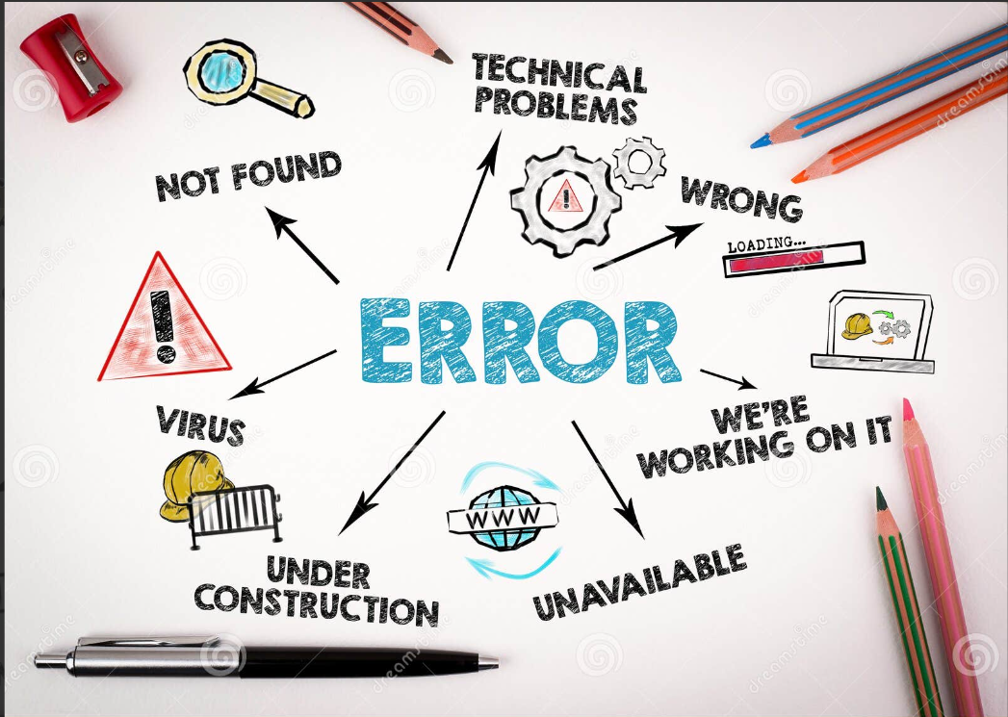
ptr++; } } int main() { const char *code = "#include <stdio.h>\n\n" "int main() {\n" " if( ; ) {\n" " printf(\"Empty if statement\\n\");\n" " }\n" " for( ; ; ) {\n" " printf(\"Empty for loop\\n\");\n" " }\n" " while( ; ) {\n"

Slide 12
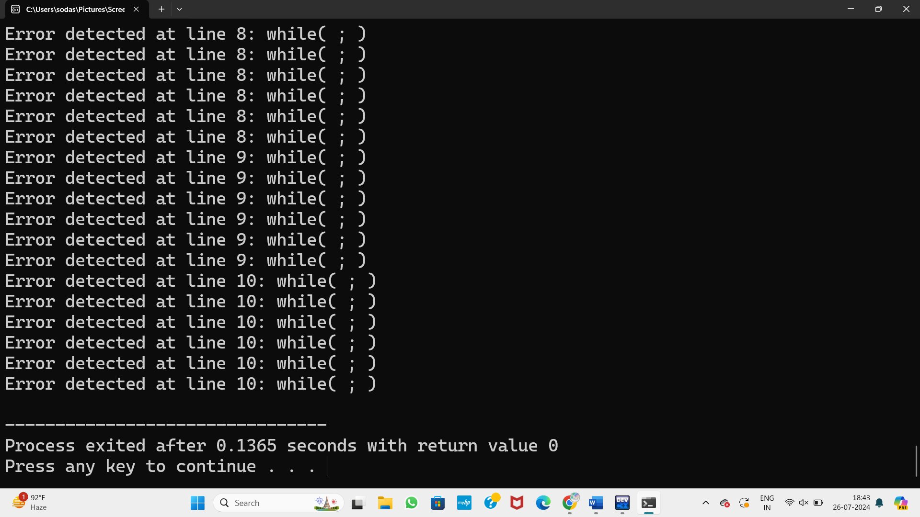
" printf(\"Empty while loop\\n\");\n" " }\n" " return 0;\n" "}\n"; detect_errors(code); return 0; }

Slide 13
CONCLUSION
The development of a robust error detectorts a significant advancement in ensuring code quality, reliability, and maintainability in s and highlighter tool for codebases, similar to "Code Guard," represenoftware development projects.
By leveraging sophisticated algorithms, customizable rulesets, and seamless integration into development workflows, such a tool empowers developers to proactively identify and address errors, code smells, security vulnerabilities, and performance bottlenecks early in the development process
.Through a comprehensive review of relevant research papers and articles, we have gained insights into the foundational principles and methodologies underlying code analysis, error detection.

Slide 14
FUTURE WORK
➨ Enhanced Machine Learning Models: Future iterations of Title Code Guard could incorporate more advanced machine learning models, including deep learning techniques, to improve error detection accuracy. By training on larger and more diverse datasets, the tool can better understand context-specific nuances and predict potential issues that current models might overlook.
➨ Support for Additional Programming Languages: Expanding the range of supported programming languages will make Title Code Guard more versatile. This could include not only popular languages like Rust, Go, and Swift but also domain-specific languages used in niche industries, thereby catering to a wider developer audience.

Slide 15
REFERENCES
➨Fowler, M. (1999). Refactoring: Improving the Design of Existing Code. Addison-Wesley Professional.
➨Martin, R. C. (2008). Clean Code: A Handbook of Agile Software Craftsmanship. Prentice Hall.
➨Beck, K. (2002). Test Driven Development: By Example. Addison-Wesley Professional.
➨ Spinellis , D. (2006). Code Reading: The Open Source Perspective. Addison-Wesley Professional.
➨Bessey, A. (2010). A few billion lines of code later: Using static analysis to find bugs in the real world. Communications of the ACM, 53(2), 66-7.

Slide 16
THANK
YOU!

